Slide 1

Art Gallery
Matthew Gardiner
Matthew Gardiner

Slide 2
Project Description and Principal Use Cases
Description
Art Gallery is a website application that allows users to sell and purchase art.
Primary Use Cases
UC-2: Buy or Sell Art
UC-5: Collections Page
UC-8: Manage Art Gallery

Slide 3
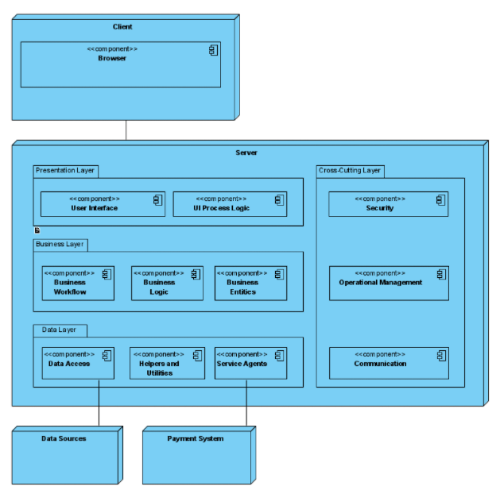
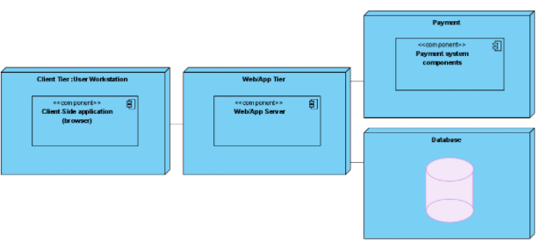
OUTCOME OF ITERATION 1
Web Application module view with external payment system:
Established iteration goal from drivers:
CRN-1 Establish Overall System Structure
All Primary Functional Requirements
All high risk QAs
All Constraints
Choose Design Concepts to satisfy structural drivers
Logically structured as Web Application
Physically structured as three-tier
Create initial Module view
Create initial Deployment Diagram
Three-tier Deployment Diagram:

Slide 4
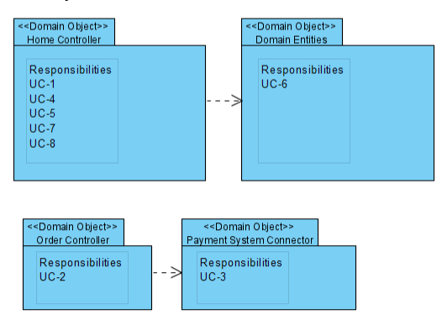
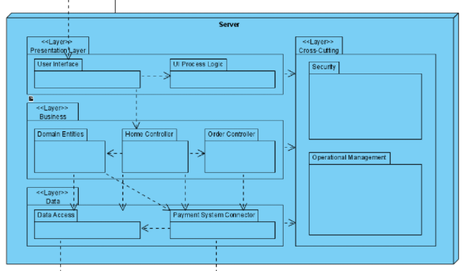
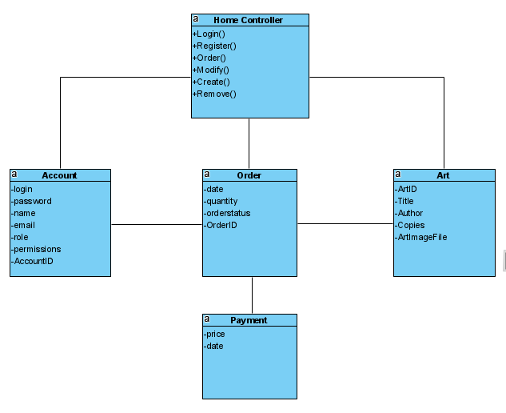
OUTCOME OF ITERATION 2
Established iteration goal from drivers:
UC-2 Buy or Sell Arts
UC-5 Collection Page
UC-8 Manage Art Gallery
Create models
Addition of Home Controller, Order Controller, Payment system Connector, Domain Entities
Domain Objects:
Domain Model:
Updated Module View:

Slide 5
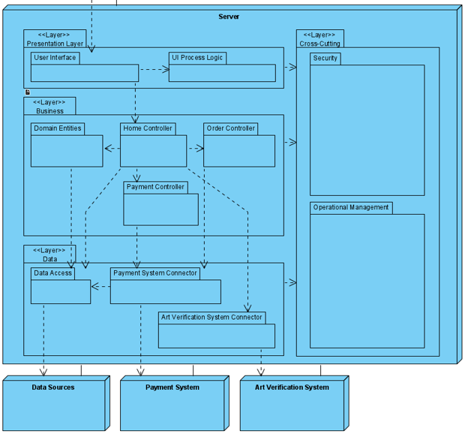
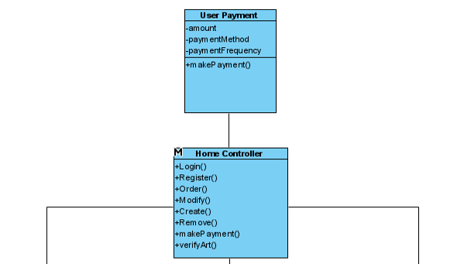
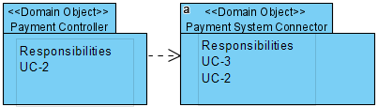
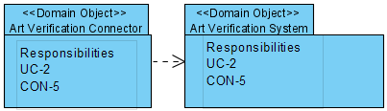
OUTCOME OF ITERATION 3
Established iteration goal from drivers:
UC-2
Sell functionality
CON-5
Verify Art
Addition of Payment Controller
Addition of Art verification system
Updated Module View:
Updated Domain Model:
New Domain Objects:

Slide 6
Thanks
Matthew Gardiner

